Slide 1


Community Needs Evaluation
2018
Metropolitan Social Services
Strategic Planning and Research

Slide 2

Welcome
Catholic Charities of Tennessee

Slide 3
Welcome
Renee Pratt
Executive Director, Metropolitan Social Services

Slide 4

For her commitment to the establishment of a CNE

Slide 5
Welcome
Pastor William Harris
Chairman, Metropolitan Social Services Commission

Slide 6
Mayor’s Office Remarks
Anne Havard
Senior Advisor – Economic Opportunity

Slide 7

Document
Agency
Event
Momentum

Slide 8
Mission Statement:
Metropolitan Social Services
Empowers
Davidson County
Residents to Achieve
Economic Stability and
Social Well-Being.

Slide 9
Socioeconomics & Workforce
Dr. Garrett Harper

Slide 10
CNE

Slide 11
+6
Net daily population change
-7
Net daily migration
Davidson County 2016-2017
2
CNE

Slide 12
14.5%
Poverty
Davidson County (2017)
14.8% (2016)
13.4% US
15.0% TN
3
CNE

Slide 13
Poverty Population, Number and Rate
Davidson County
4
CNE

Slide 14
Approximately 1 in 7
Nashvillians lives in poverty
If you are….
A single-mother with children under 5 yrs, it is 1 in 2 (50.8%)
A veteran age 55 to 64, it is nearly 1 in 6 (16.5%)
A high school graduate only, it is nearly 1 in 6 (16.3%)
Under 18, it is nearly 1 in 4 (23.7%)
African-American, it is 1 in 5 (20.8%)
A part-time worker, it is more than 1 in 3 (37.0%)
A person with a disability, it more than 1 in 5 (21.7%)
5
CNE

Slide 15
At 125% percent of poverty level –
poverty rates rose for some 2017 vs 2016:
Under 18 31.5% 28.7%
Black or African-American 24.5% 27.7%
Hispanic 31.6% 30.1%
High School Graduates 20.4% 20.2%
With a Disability 27.4% 27.9%
Worked less than Full-time, Year-round 29.1% 26.0%
Nearly a third of Nashville residents live at
200% of poverty or lower
CNE

Slide 16
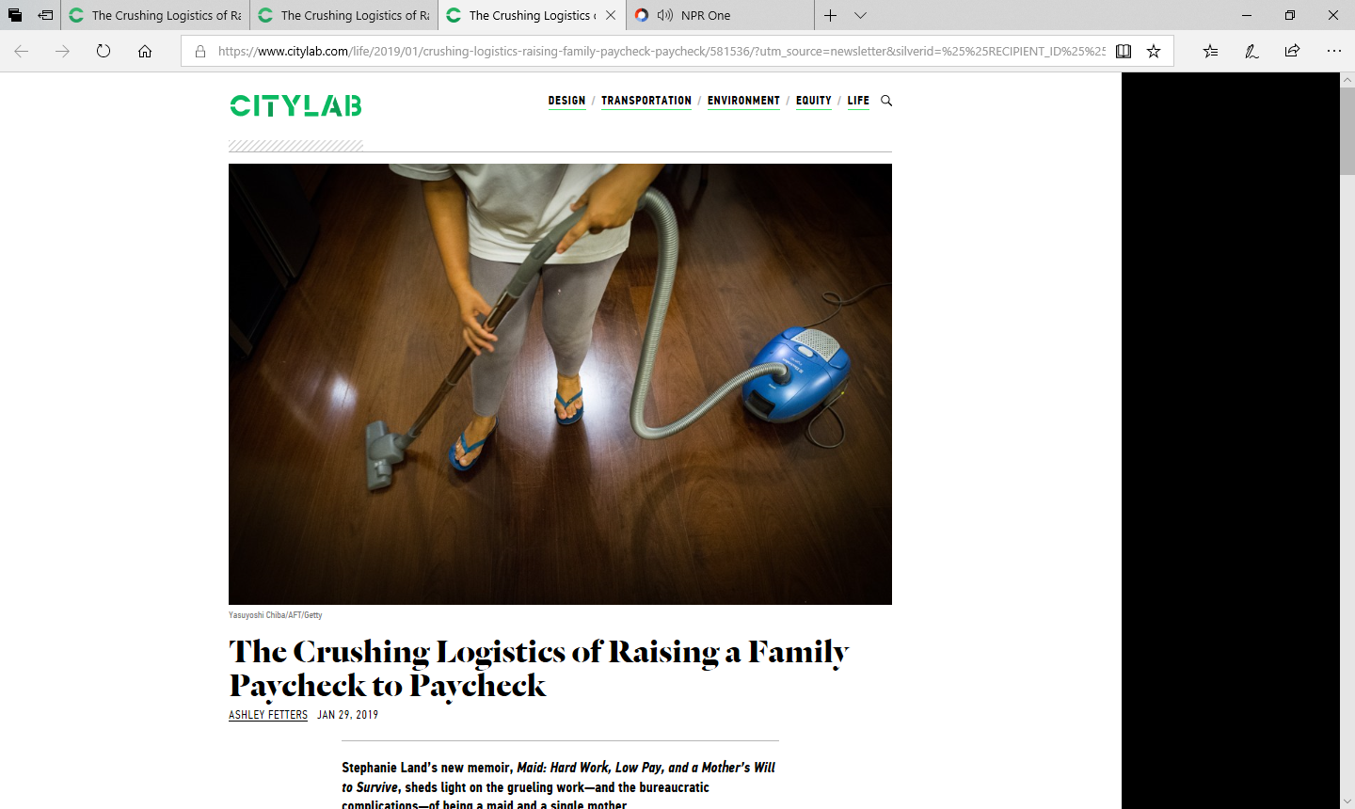
January 29, 2019

Slide 17
60%
Between ages of 25 and 60,
over 60% of the population experiences relative poverty
(in the bottom 20% of earners)
8
Source: Rank & Hirschl. (2015). The likelihood of relative poverty over the life course. PLoS ONE 10(7).

Slide 18
THE ECONOMICS OF POVERTY
Relative poverty = family’s income insufficient to meet society's average standard of living.
Situational poverty = caused by sudden crisis or loss and often temporary - environmental disasters, divorce, severe health problems.
Generational poverty = at least two generations born into poverty - Families not equipped with tools to move out of their situations.
Absolute poverty = scarcity of necessities: shelter, running water, food - focus on day-to-day survival.
Source: Jensen, Eric. (2009) Teaching with Poverty in Mind.

Slide 19




The Nearness of Household Poverty

Slide 20
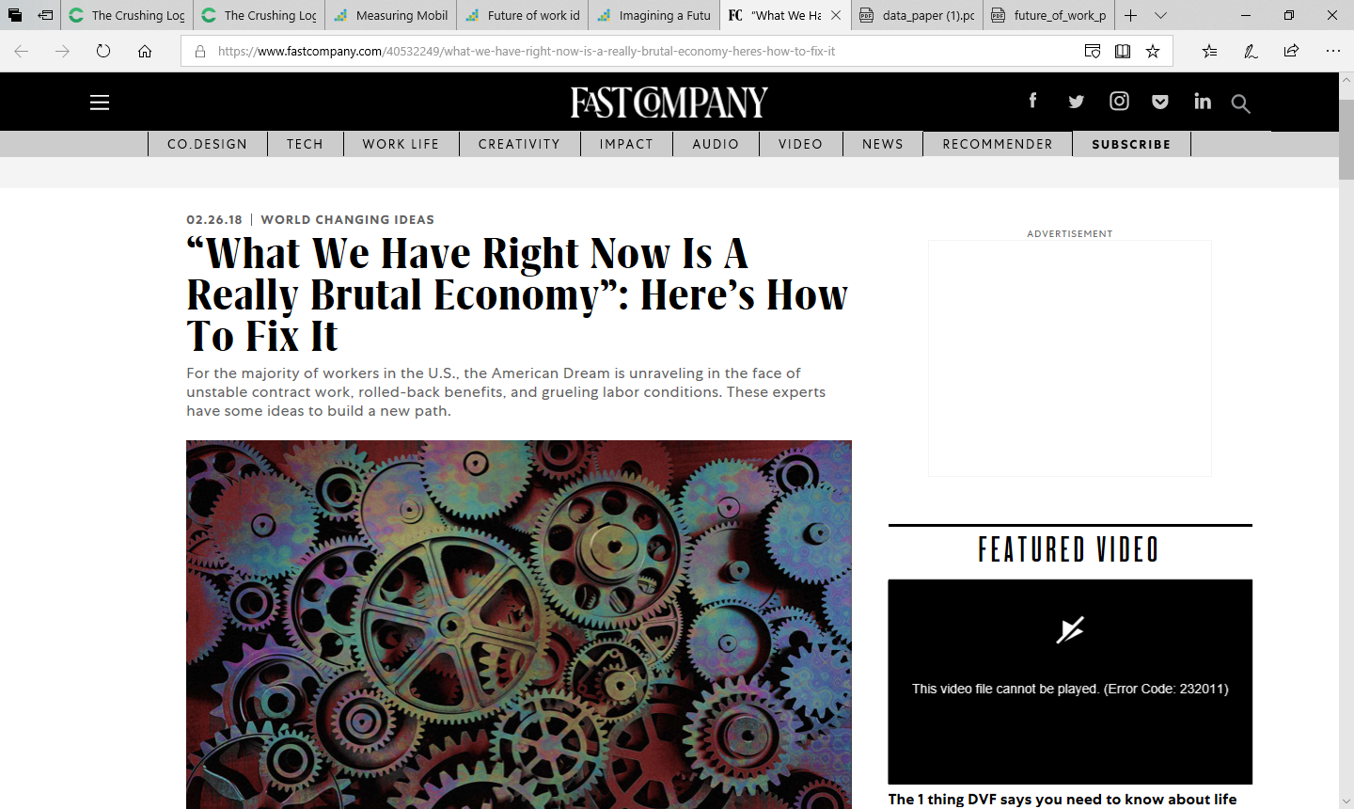
‘The American Dream is unraveling in the face
of unstable contract work, rolled-back benefits,
and grueling labor conditions.’
February 26, 2018

Slide 21

Making Ends Meet
FOOD
HEALTHCARE
CLOTHING
CHILDCARE
HOUSING
TRANSPORTATION

Slide 22
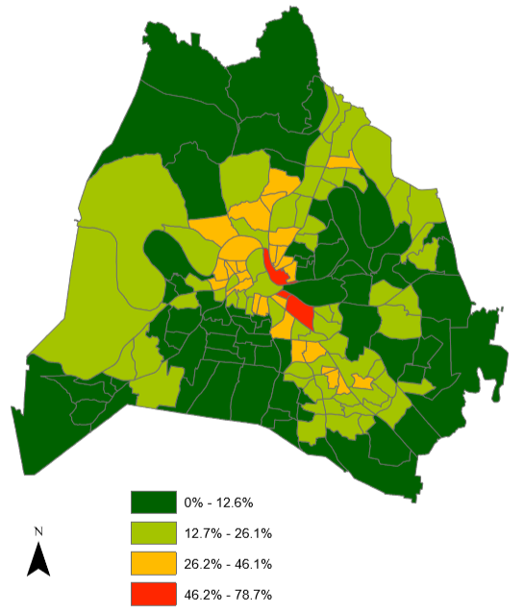
Percent of Population below Poverty Level by Census Tract
Davidson County, 2017
CNE

Slide 23
What has changed?
Or
Why Poverty amidst Plenty?

Slide 24

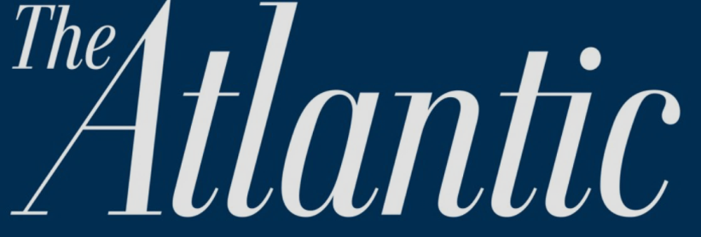
July 2015
A World Without Work
For centuries, experts have predicted that machines would make workers obsolete. That moment may finally be arriving. Could that be a good thing?

Slide 25

‘Planning for the No-Jobs,
Post-Work Economy’
FORTUNE
December 2015

Slide 26
Percent of Children Earning More than their Parents
By Parent Income Percentile
100
1940
80
1950
60
1960
Pct. of Children Earning more than their Parents
40
1970
1980
20
0
0
20
40
60
80
100
Parent Income Percentile (conditional on positive income)
Source: Opportunity Insights
Notes:
Fig 1a

Slide 27
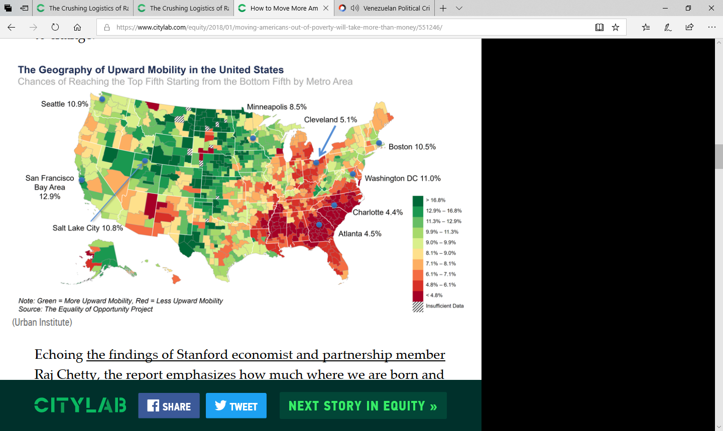
The Geography of Upward Mobility
Chances of Reaching the Top Fifth Starting from the Bottom Fifth
Source: Urban Institute

Slide 28
Education disparities matter
High School Education, Bachelor’s Degree or Higher
by Race and Ethnicity
Davidson County, 2017
CNE

Slide 29
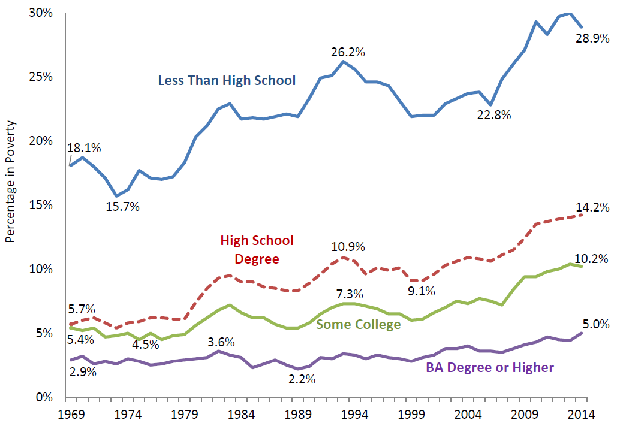
Education (alone) will not reduce poverty
Poverty Rate of Adults Age 25+ by Education
Source: US Department of Health and Human Services

Slide 30
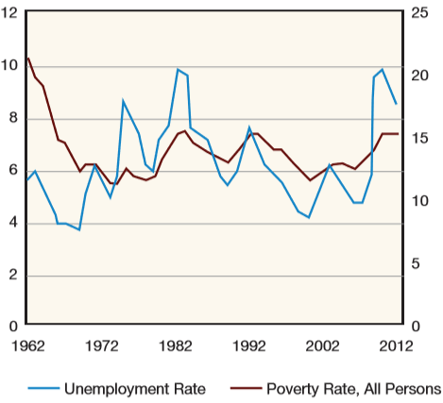
Jobs (alone) will not reduce poverty
Unemployment
Rate
Percent in
Poverty
Source: Jobs, joblessness, and the new American poverty. Pathways, Stanford University, Summer 2014

Slide 31
Looking Forward
22

Slide 32
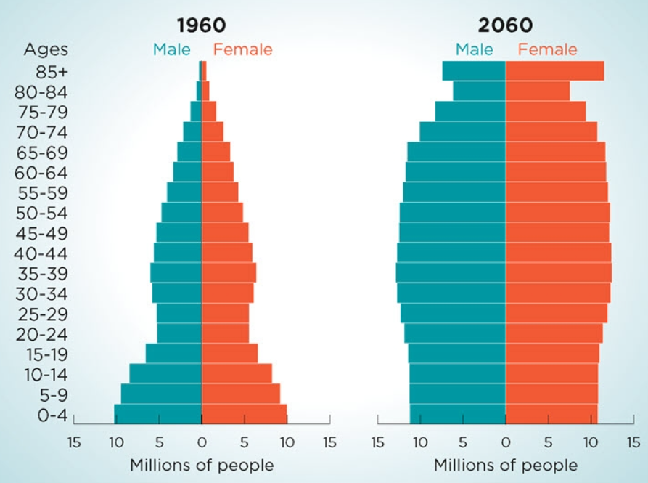
US Population – Past and Future
Today
Age 60 and over
6.7 million
in poverty
U.S.
10,625
in poverty
Davidson County
Source: US Census Bureau

Slide 33

The Focus on Those with
Financial Struggles
The Working Poor
Single-parent Households
The Formerly Incarcerated

Slide 34

On the Horizon?
"It is absolutely obvious that a big chunk of people have been left behind"
Jamie Dimon
CEO, JP Morgan

Slide 35
What Data Reveal
Poverty rate steady BUT number & type exceed pre-Recession
Economic shocks intensify long-term poverty
Transformation in work and society
OPPORTUNITIES
Strategic direction and research
Address challenges holistically
Evidence-based, comprehensive approaches to systemic change

Slide 36
Aging & Disability
Julius Witherspoon

Slide 37

Aging
10,000 Baby Boomers turned 65 today
Celebrate!

Slide 38
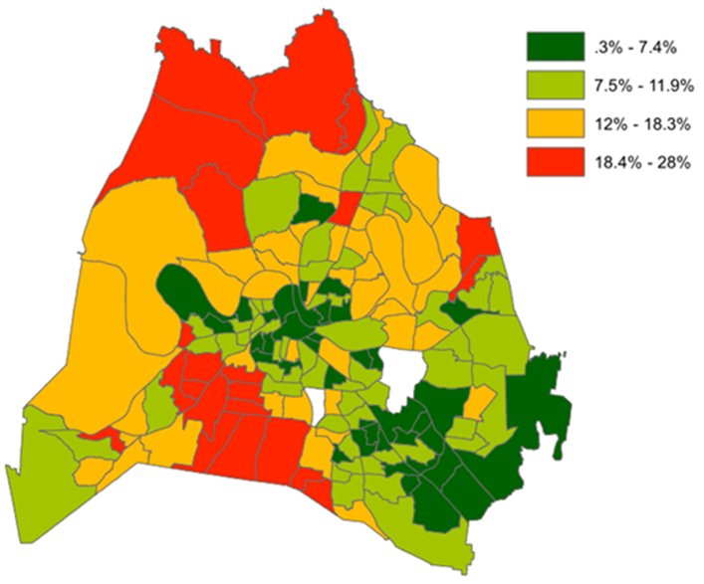
Where people age 65 and over live by Davidson County Census Tracts
Source: Data from U.S. Census Bureau, Map from Metropolitan Planning Department

Slide 39


Disability
3

Slide 40
Disability increases with age
4
Source: U.S. Census Bureau, 2017 American Community Survey

Slide 41


Persons with a Disability are more likely to be unemployed and earn less than persons without a Disability
5

Slide 42

More seniors are choosing to continue working and postponing retirement
6

Slide 43



Retirement
Depiction vs. Reality
7

Slide 44
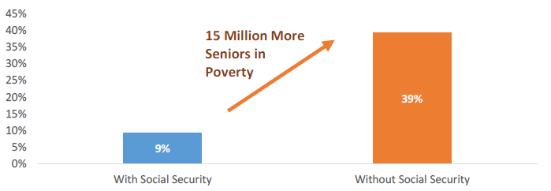
Social Security keeps many older adults from living in Poverty
Source: https://www.economicpolicyresearch.org/images/docs/research/retirement_security/Downward_Mobility_in_Retirement_P_N.pdf
8

Slide 45
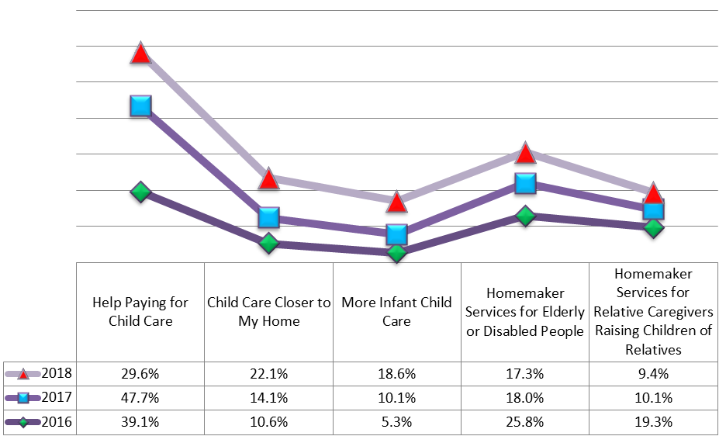
Grassroots Community Survey
Home and Community Based Services
Source: 2016 -2018 Metro Social Services Grassroots Community Survey
9

Slide 46
Food & Nutrition
Julius Witherspoon

Slide 47
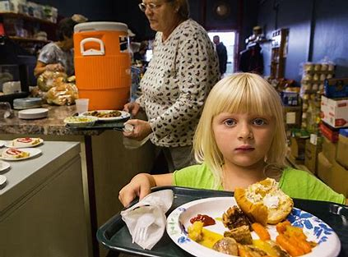


Who is more likely to be hungry?
Children and youth- age 18 and under
Adults age 65 and over
1

Slide 48

Food insecurity is the limited or uncertain availability of nutritionally adequate and safe foods or limited or uncertain ability to acquire acceptable foods in socially acceptable ways.
2

Slide 49
Food Insecurity Rates have declined
1 in 5 children remain food insecure (2018)
Davidson County
Source: Second Harvest Food Bank of Middle Tennessee
3

Slide 50
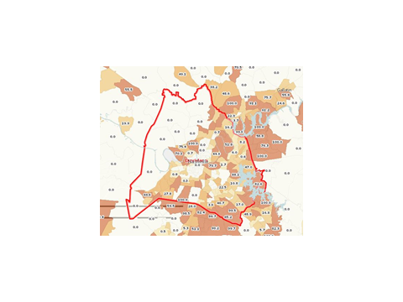
Davidson County Food Insecurity Map
Food Insecurity by Census Tracts
Highlights
Where you live impacts your Food Security
One census tract has a 77% food insecurity rate and two census tracts have 0% food insecurity rates
4

Slide 51
Emergency Food Box Distribution
Second Harvest Food Bank
5

Slide 52
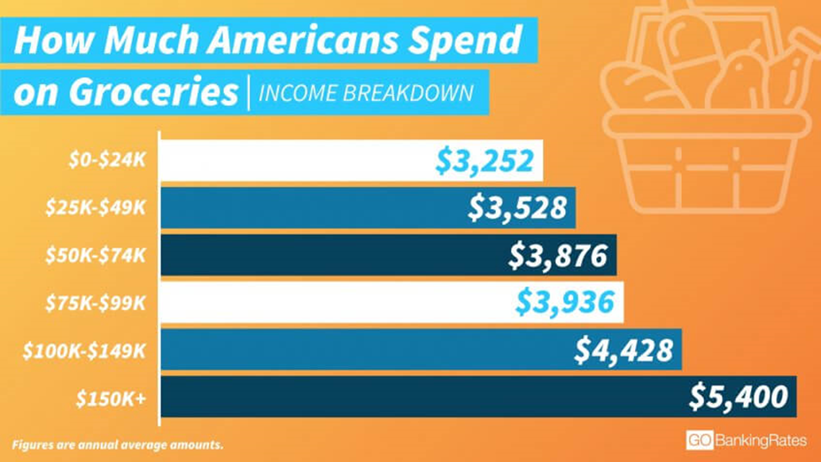
Spending on Food by Income Breakdown
6

Slide 53
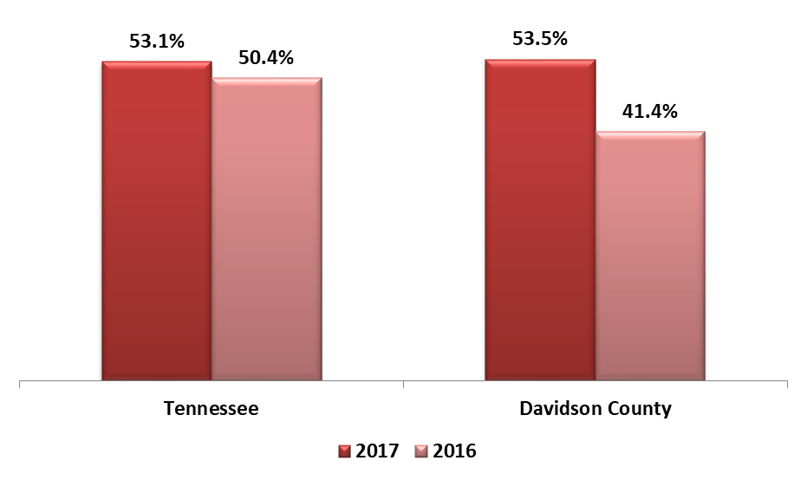

Percent of Households receiving SNAP assistance living below the poverty line
Source: U.S. Census Bureau 2017 American Community Survey
7

Slide 54

Percent of Households Receiving SNAP Benefits
Source: U.S. Census Bureau 2017 American Community Survey
8

Slide 55

Metro Social Services Provides Emergency Meals to Walk In Clients
479 unique individuals received emergency meals in our offices served by MSS staff this past fiscal year!!
9

Slide 56
Grassroots Community Survey Findings
Note: For the first time Food & Nutrition ranked higher than Housing and Related Assistance
10

Slide 57
Housing
Lee Stewart

Slide 58

Notes:
I believe in Nashville’s prosperity and growth. I’ve been here for 50 years, and like many of you have seen big changes, most of the exciting. However, we’ve also seen a widening gap between families doing really well and those struggling financially… But I still believe we can change the trajectory

Slide 59
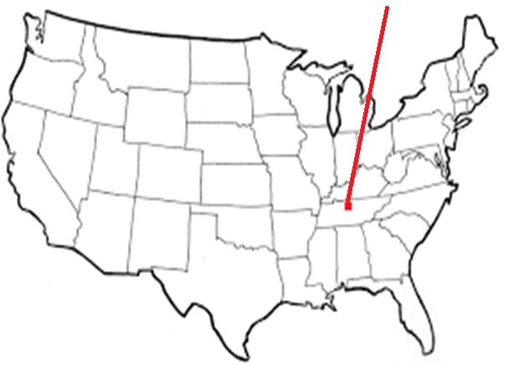
Fastest Gentrification
Housing Market Rank
#5
#6
Notes:
Nashville’s housing market ranked in the top five in overall real estate prospects for 2019, Number 1 in Homebuilding prospects, number 8 in US retail property “buy” recommendations, and number 6 in local market investor demand.
We’re doing great as a city & I think we can afford to address some inconsistencies in that growth.
There is a report called Emerging Trends in Real Estate... 2019 is 40th year - published by accounting firm PwC & the Urban Land Institute. I recommend looking this up there’s a link in the CNE.

Slide 60

Multi-Unit Building Permits
5,751
2016
2,439
2017
– 3,312
Notes:
The wild rush to build multi-unit housing, especially high-end for those with high-paying jobs, appears to be slowing. Over 2 thousand less permits requested in 2017. Single family permits remained about the same from 2016-2017 (3815>3971)
Maybe some housing unit costs are going to come down?
State of the Cities Data Systems (SOCDS
https://socds.huduser.gov/permits/

Slide 61
More Renter Vacancies
7% 2017
1.4% 2016
Notes:
Does more vacancies mean more affordable places to live are open?

Slide 62
rentjungle
$ 1,549
rentcafe
$ 1,343
HUD FMR
$ 1,103
Notes:
Well, maybe not…These are rents for 2 bedroom apartment…so what do you do with a Section 8/Housing Choice Voucher at Fair Market Rate when landlords can make more money at market rate?
As of last September 2018, there were 15,029 applicants on a waiting list for Vouchers.
>>>If my arithmetic is right, a family would need to earn $3,676 per month [$44,112 per year] to afford the HUD FMR without spending more than 30% of their income on housing.
-------------------------------------
Full-time minimum wage - $15,080, 2-earner family = $30,160 ( -13,960)

Slide 63
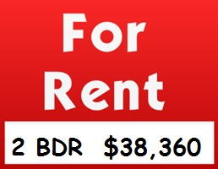
Emergency Medical Technician $ 31,043
Child Care Worker $ 28,439
Home Health Aide $ 26,501
Housekeeper $ 22,778
Notes:
Workers Nashville Needs Can’t Afford To Live Here. This for-rent amount is from the 2019 Paycheck to Paycheck database for the Nashville area. As you can see, some entire paychecks don’t cover rents
- If you don’t know about it already, look up the Paycheck to paycheck db.
- Also…check out H+T Index to look at how transportation is a hidden housing cost

Slide 64
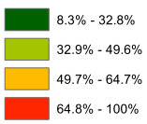
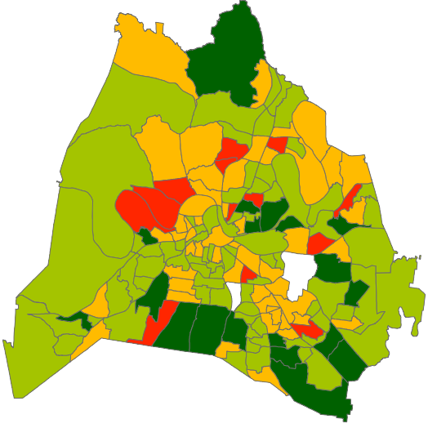
Paying Too Much
Notes:
In the orange & red areas, over half of the renters pay more than 30% of their income for housing and related expenses. Low-income cost burdened families have to make hard choices among normal expenses like food, rent, utilities, healthcare, childcare…
In CNE
There were 80,000 households earning less than $50,000 that were cost-burdened.
Total households 2015 = 274,187
2015: 100% of Poverty Level Family of 4 = $24,250

Slide 65

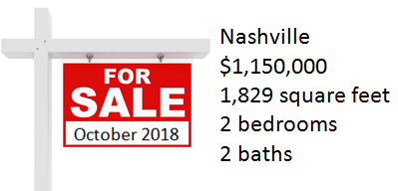
Movin’ Out…
Trousdale , Sumner, Robertson, Rutherford, Cheatham, Dickson, Wilson
Notes:
Families are moving out of Davidson County because rents are unaffordable. Also in-migration is less in the past couple of years, down about a thousand a year from 2014 to 2017
Longer commutes, more fuel, delays during inclement weather = problems for low-wage workers AND their employers

Slide 66
Food Insecurity
Renter Reported Hardships
30%
19%
Unmet Medical Care
Notes:
Low-income families have to make hard choices. Choices…between rent and…
National data from Urban Institute 2017 Well-Being and Basic Needs Survey - material hardships reported by renters age 18-64
In CNE

Slide 67
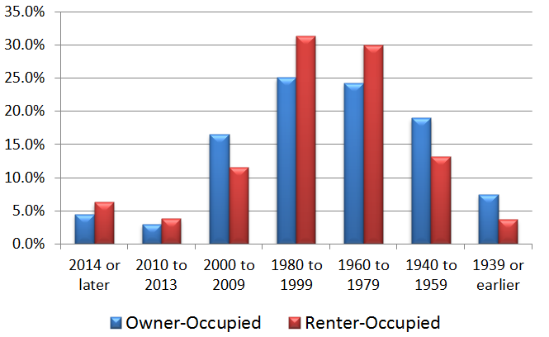
≈1/2 of Our Housing: Over 50 Years Old
Notes:
Even if you find something affordable to rent, it’s likely to be older and in need of upkeep. For example, some research shows that many single-family dwellings have been bought by large and small investors to rent…and many of these have maintenance needs that are ignored by the owners. Given the lack of available buildable land, and the increased costs of building, it becomes more important to rehab existing structures.
For perspective about the age of houses and the culture when they were built, in the attics of houses built in the ‘60s you might find toys like the BetsyWetsy doll [just exactly what you think], spirograph [for drawing interesting circles on paper] and Mr. Potato Head [using real potatoes].
In a new Report Improving America’s Housing – new home construction is down, BUT home remodeling market has expanded by more than 50% since the Great Recession - $425 billion in 2017

Slide 68

MSS Front Desk Survey since July 2013
> 6,000 Customers Surveyed
Housing
& Related Assistance
86.5%
Notes:
Over 6,000 MSS clients have completed a checklist of 8 need areas
Can choose Housing/Utilities - Food, Meals – Information - Health Care - Case Mgmt – Counseling – Employment - Transportation
Data are consistent by month, by quarter, by year, from 2013 to now

Slide 69
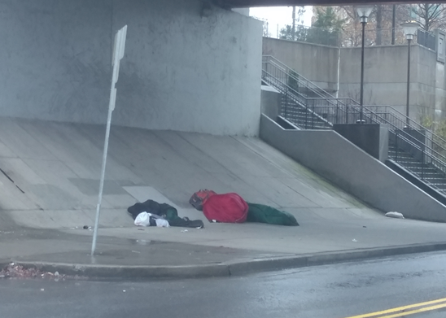
Let us not forget…
Notes:
The worst housing of all is no housing.
The CNE contains lots of internet links for those who want to dig deeper into a specific area.

Slide 70
A 21st Century Perspective
Abdelghani Barre

Slide 71


Economic Disparity in Nashville
Struggle for Financial Self-Sufficiency

Slide 72
Structural
and
Persistent poverty

Slide 73


Increase in households headed by a female single parent
Struggle with childcare
Not being able to pursue education
Unlikely to attend or complete job training
More likely to rely on assistance
Children growing up poor more likely to be poor adults

Slide 74

Increased economic disparities experienced by the working poor
Work no longer secures financial stability
Earnings do not cover expenses
Stagnant wages
Median Worker Earnings
$34,013 (2017)

Slide 75




Outmoded public systems of care for people in crisis
Public assistance created for 20th Century
TANF, UI, SNAP, Housing Subsidies

Slide 76
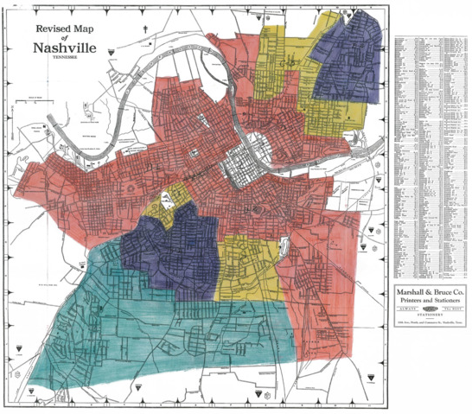
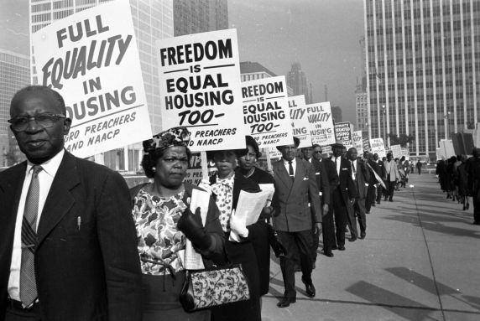
Residual impact of
historical and institutional
discriminatory practices

Slide 77
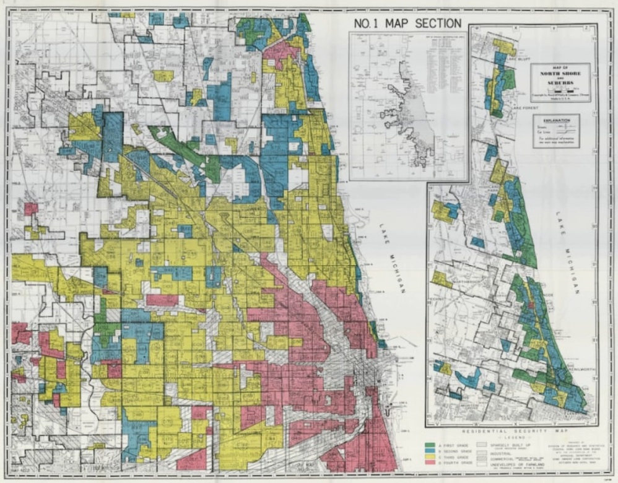

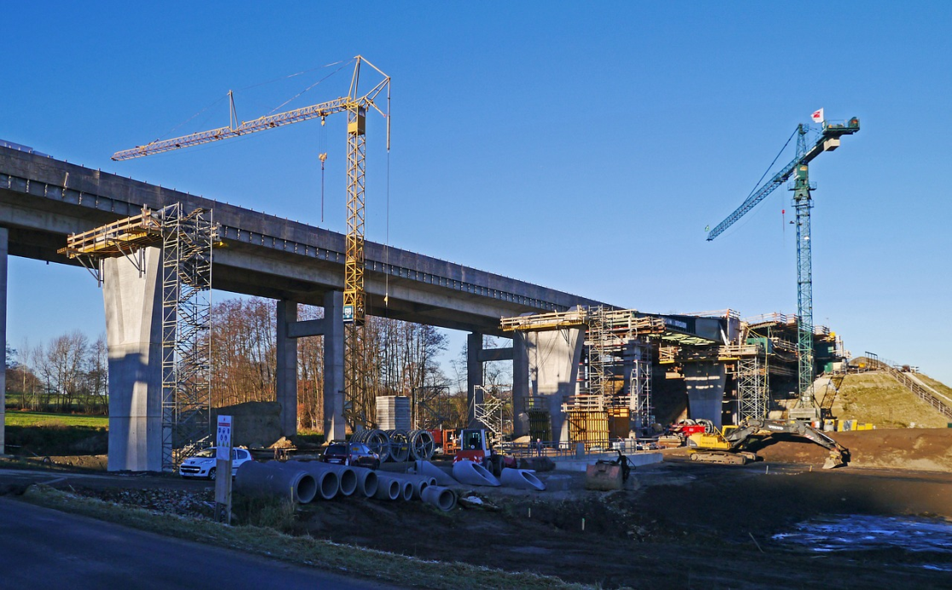
Redlining and highway construction that isolates neighborhoods

Slide 78

Underfunded and unequal allocation
of public education funding/resources

Slide 79
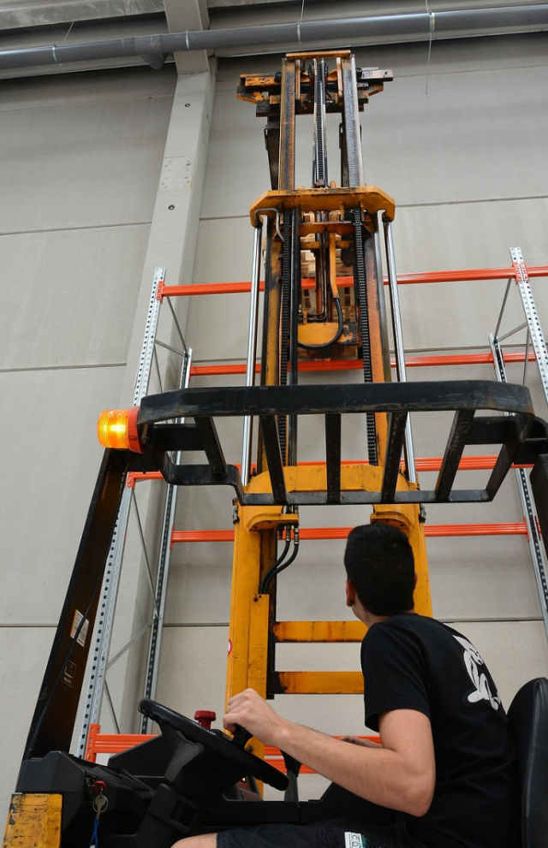


Unequal access to employment opportunities
jobs
training
transportation

Slide 80



Lack of equity in wealth building opportunities
lending institutions and public contracts

Slide 81

Criminal justice system imbalances

Slide 82

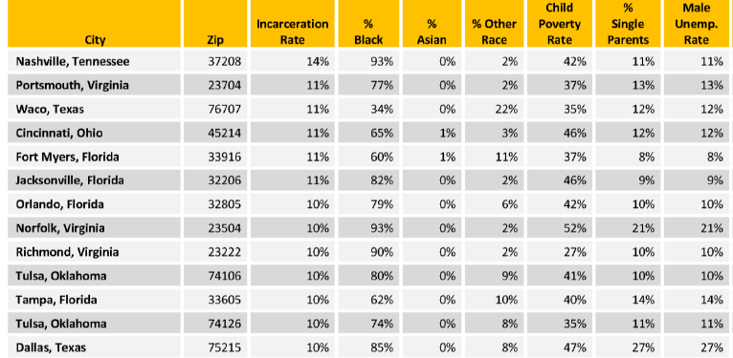
ZIP Code 37208
#1 in US
Neighborhoods with Highest Rates of Incarceration
Source: Brookings Institution, 2018

Slide 83
Disparities in job opportunities
Nashville overall unemployment rate
is about 2%
Individual Census Tracts range as high as
36% unemployment rate

Slide 84
Unemployed Civilian Workforce
Age 16 and Over
by Census Tract
Davidson County 2013-2017
14
CNE
Source: American Community Survey, 5-year estimate

Slide 85
And real disparities persist ….
Unemployment by Race and Ethnicity
Davidson County
CNE

Slide 86
More Conversation on
Single Parent Households
Making Work Gainful
Reforming Public Systems of Care

