Slide 1



Help & Hope
Tracking the $50M Investment in Addressing Nashville Homelessness

Slide 2

Overview
2
Total Investment : $50 million in Homelessness
Temporary Interim Housing-RS 2022-1698-$9M to Homeless Impact Division, temporary interim gap housing
Gap Financing for Permanent Supportive Housing-RS 2022-1696-$25M to Metro Development and Housing Agency for low-cost loans for affordable housing units
Housing First Supportive Services-RS 2022-1697-$9M to Metro Homeless Impact Division for Housing First Supportive Services
Low Barrier Housing Collective and Competitive Grants-RS 2022-1699-$7M to Homeless Impact Division for Low Barrier Housing Collective & Competitive Grants
Tracking the $50 Million Investment in Homelessness
https://www.nashville.gov/departments/office-homeless-services/data
Notes:
As we shared last month, your historic investment of $50m passed on October 4 to address homelessness is beginning to see progress.
The four buckets are:
- Interim housing
- Gap financing to create more permanent supportive housing
- Housing first support services
- And finally, Low Barrier Housing Collective and Competitive Innovation Grants

Slide 3
March Report Highlights
3
The lawsuit that Metro joined against HUD in response to the issuance of a new Notice of Funding Opportunity (NOFO) late last year continues to move through the court. While the preliminary injunction was granted to the plaintiffs, HUD has appealed that ruling. Metro Legal continues to engage with the other parties in the case as they move toward a summary judgment.
The Appropriations Bill that was passed by Congress and signed by the President in January contained several provisions related to the Continuum of Care (CoC) program. The bill mandates that HUD renew CoC grants that expire in the first quarter of 2026; if HUD does not make awards by April 1, all of the grants that expire in the second quarter of 2026 must be noncompetitively renewed.
The Metro Emergency Overflow Cold Weather Shelter continues to operate through the end of March. The shelter will be open tonight due to below freezing temperatures, which will be its 53rd night of operation this year.
OHS hosted a day-long training with Paul Warner entitled “Level Setting for the New Year.” He trained several community partners and the entire OHS staff around issues like communication, conflict, crucial conversations, and how to create a positive workspace. The participants expressed that they learned several important concepts that they will carry back to their workplace.
OHS hosted our annual Homelessness Planning Council (HPC) retreat last month. This retreat included an activity with Paul Warner, training from OHS, and training from Metro Legal. It also began the process of creating a new HPC strategic plan, as the current three-year plan is set to expire this year. The HPC created a SWOT analysis and began to assess the progress on goals from their current strategic plan.
Notes:
As we shared last month, your historic investment of $50m passed on October 4 to address homelessness is beginning to see progress.
The four buckets are:
- Interim housing
- Gap financing to create more permanent supportive housing
- Housing first support services
- And finally, Low Barrier Housing Collective and Competitive Innovation Grants

Slide 4
$25M Gap Financing for Permanent Supportive Housing RS 2022-1696
4
UPDATE: March 2026
Affordable Housing Gap Financing (AHGF) Program:
Under MDHA’s oversight, the AHGF program awarded a total of $16,617,591.67 to create 88 AHGF units while providing needed gap financing to projects that created 735 affordable units.
Unobligated funds ($7,551,528.75) were remitted to the Barnes Housing Trust Fund for Permanent Supportive Housing (PSH) and deeply affordable housing projects as outlined in Council Resolution RS2022-1696 (amended by RS2024-240), effective April 1, 2024.
The Barnes Housing Trust Fund awarded a total of $7,551,528.75 to create 80 AHGF units while providing needed gap financing to a project that created 120 affordable units.

Slide 5
$25M Gap Financing for Permanent Supportive Housing RS 2022-1696
5
DEVELOPER | UNITS FUNDED WITH AMERICAN RESCUE PLAN FUNDS | TOTAL AFFORDABLE HOUSING UNITS | UNITS COME ONLINE | AWARD AMOUNT | FUNDING ROUND
Urban Housing Solutions | 17 | 165 | Now Online | $3,000,000 (repay) | MDHA First
The Clear Blue Company | 10 | 238 | Now Online | $2,584,620 (repay) | MDHA First
Shelby House 1, LP | 0 | 0 | Offline | $2,100,000 (repaid) | MDHA First Repaid
Woodbine Community Organization | 24 | 36 | Now Online | $2,000,000 (forgivable) | MDHA First
Be A Helping Hand | 2 | 4 | Now Online | $464,701.63 (forgivable) | MDHA First
Woodbine Community Organization | 8 | 39 | Now Online | $1,560,000 (forgivable) | MDHA Second
Be A Helping Hand | 2 | 2 | Now Online | $191,208.04 (forgivable) | MDHA Second
Shelby House 1, LP | 0 | 0 | Offline | $712,544.00 (repaid) | MDHA Final Repaid
AGB Real Estate | 25 | 131 | Now Online | $4,004,518.00 (repay) | MDHA Final
I Am Next | 80 | 120 | Now Online | $7,551,528.75 | Barnes Fund
TOTAL | 168 53 units: 0-30% of AMI 115 units: Permanent Supportive Housing | 735 | May 23 – Dec 25 | $24,169,120.42 **Per RS 2022-1696, the administration fee to MDHA is $830,879.58 based on 5% of total awards.
*Affordable Housing Gap Financing
Units in blue are currently open and online.

Slide 6
$9M Housing First Supportive Services RS 2022-1697
6
UPDATE: March 2026
Metro Council approved all agreements for the Housing First Supportive Services
  Colby’s Army $143,629
    Peer Support Services
  Mending Hearts $3,000,000
    Housing Support Coordination
    Vital Document Collection
    Resource Referrals and Connections
      Physical and Mental Health
      Substance Use Recovery
      Benefits and Assistance Programs
      Employment Resources
      Essential Items (food, clothing, household items, etc.)
  Park Center $900,000
    SOAR Services
  Room In The Inn $275,000
    Second award: $220,805.08
    Provide Nutritious Meals to those residing in Interim Housing Programs
  Step Up on Second $2,499,051
    Housing Support
    Vital Document Collection
    Resource Referrals and Connections
      Physical and Mental Health
      Substance Use Recovery
      Benefits and Assistance Programs
      Essential Items (food, clothing, household items, etc.)
  United Neighborhood Health Services $1,961,514.92
    Street Medicine
    Medical Clinic Services on site at Interim Housing Program locations
    Pharmacy Services

Slide 7
$9M Housing First Supportive Services RS 2022-1697
7
UPDATE: March 2026
 |  | Mending Hearts | Step Up on Second
 | Total Number of Individuals Served | 205 | 297
 | Total Number of Households Served | 191 | 195
 | Chronically Homeless | 1.5% | 21.9%
 | Veteran Status | 2.9% | 2.7%
 | At Least 1 Disabling Condition | 91.7% | 62.6%
 | 2 or More Disabling Conditions | 72.7% | 36.7%
 | Services Provided
 | Total Number of Services Provided | 5460 | 12,117
 | Total Clients Received Any Service | 204 | 297
 | Basic Needs | 29 | 617
 | Benefits Assistance | - | 815
 | Case Management | 4073 | 9927
 | Emergency Food Assistance | - | 120
 | Financial Literacy Assistance | - | 23
 | Job Readiness | - | 45
 | Life Skills Education | - | 359
 | Local Bus Fare/Ticket | 1077 | -
 | Local Transportation (Ride Share) | 215 | 174
 | Mental Health Supportive Services | 35 | 24
 | Substance Use Education and Prevention | 31 | 13
 |  | Mending Hearts | Step Up on Second
 | Race and Ethnicity
 | American Indian/Native Alaskan/Indigenous | 0.5% | 0.3%
 | Asian | 0.0% | 0.0%
 | Black | 31.2% | 54.2%
 | Hispanic/Latinx | 2.0% | 2.4%
 | Middle Eastern or North African | 0.0% | 0.0%
 | Native Hawaiian or Pacific Islander | 0.0% | 0.0%
 | White | 63.4% | 40.4%
 | Multi Racial/Ethnic | 2.9% | 2.4%
 | Client Declined to Answer | 0.0% | 0.3%
 | Age
 | 0-17 | 5.4% | 25.9%
 | 18-24 | 12.2% | 6.1%
 | 25-34 | 23.4% | 14.1%
 | 35-44 | 28.3% | 17.5%
 | 45-54 | 23.4% | 17.5%
 | 55-64 | 7.3% | 13.1%
 | 65+ | 7.5% | 5.7%
*All data as of 2/28/2026
Notes:
The Salvation Army (TSA) – Roadway Home
All are on ARP Gap Funds with TSA
Remainder will be working on housing options including interim housing, permanent supportive housing, or permanent housing options such as Section 8
Housing NOLA transitioning case management to The Salvation Army staff
Community Care Fellowship – Mobile Housing Navigation Centers
4 Mobile Housing Navigation Centers are currently open
The Family Center will open by July 1, 2023
The Youth Center will open by September 1 , 2023
Community Care Fellowship’s ARP-1 funding ended on March 31, 2023 when the program funds were completely spent.
Beginning April 1, 2023 all Mobile Housing Navigation Centers became funded by the 2022 ARP Funding (ARP-2).
At the time of the transition, 16 clients remained in the ARP-1 programs and were transitioned over to the ARP-2 funding.

Slide 8
$9M Housing First Supportive Services RS 2022-1697
8
UPDATE: March 2026
 |  | Colby’s Army | Park Center | Room In The Inn
 | Race and Ethnicity
 | American Indian/Native Alaskan/Indigenous | 0.0% | 0.6% | 0.7%
 | Asian | 0.0% | 0.9% | 0.0%
 | Black | 17.5% | 34.3% | 11.3%
 | Hispanic/Latinx | 0.0% | 3.2% | 0.0%
 | Middle Eastern or North African | 0.0% | 0.9% | 0.0%
 | Native Hawaiian or Pacific Islander | 0.0% | 0.3% | 0.0%
 | White | 77.5% | 56.7% | 83.8%
 | Multi Racial/Ethnic | 5.0% | 2.9% | 4.2%
 | Client Declined to Answer | 0.0% | 0.3% | 0.0%
 | Age
 | 0-17 | 0.0% | 0.0% | 0.0%
 | 18-24 | 2.5% | 8.1% | 1.4%
 | 25-34 | 10.0% | 16.0% | 28.9%
 | 35-44 | 20.0% | 25.9% | 35.9%
 | 45-54 | 47.5% | 31.4% | 27.5%
 | 55-64 | 17.5% | 17.4% | 5.6%
 | 65+ | 2.5% | 1.2% | 0.7%
 |  | Colby’s Army | Park Center | Room In The Inn
 | Total Number of Individuals Served | 40 | 344 | 142
 | Total Number of Households Served | 35 | 342 | 117
 | Chronically Homeless | 47.5% | 36.6% | 87.3%
 | Veteran Status | 0.0% | 4.7% | 4.2%
 | At Least 1 Disabling Condition | 90.0% | 97.1% | 98.6%
 | 2 or More Disabling Conditions | 75.0% | 77.3% | 79.6%
 | Services Provided
 | Meals | - | - | 41,057
 | Peer Support | 40 | - | -
 | SOAR Eligibility Screening | - | 344 | -
 | SOAR Application | - | 3 | -
*All data as of 2/28/2026
Notes:
The Salvation Army (TSA) – Roadway Home
All are on ARP Gap Funds with TSA
Remainder will be working on housing options including interim housing, permanent supportive housing, or permanent housing options such as Section 8
Housing NOLA transitioning case management to The Salvation Army staff
Community Care Fellowship – Mobile Housing Navigation Centers
4 Mobile Housing Navigation Centers are currently open
The Family Center will open by July 1, 2023
The Youth Center will open by September 1 , 2023
Community Care Fellowship’s ARP-1 funding ended on March 31, 2023 when the program funds were completely spent.
Beginning April 1, 2023 all Mobile Housing Navigation Centers became funded by the 2022 ARP Funding (ARP-2).
At the time of the transition, 16 clients remained in the ARP-1 programs and were transitioned over to the ARP-2 funding.

Slide 9
$9M Housing First Supportive Services RS 2022-1697
9
UPDATE: March 2026
Spending Update:
 | Total Funds | Spending as of 2/28/26 | Remaining Funds | Funding End Date
Colby’s Army | $143,629.00 | $95,832.84 | $47,796.16 | 5/31/2026
Mending Hearts | $3,000,000.00 | $1,367,276.36 | $1,632,723.64 | 5/31/2026
Park Center | $900,000.00 | $722,259.65 | $177,740.35 | 5/31/2026
Room In The Inn | $495,805.08 | $459,120.00 | $36,685.08 | 5/31/2026
Step Up on Second | $2,499,051.00 | $1,306,210.48 | $1,192,840.52 | 5/31/2026
United Neighborhood Health Services | $1,961,514.92 | $1,278,822.19 | $682,692.73 | 4/30/2026
Total Funding | $9,000,000.00 | $5,164,981.21 | $3,835,018.79
Supportive Service Referrals continue to be processed
Hosting Bi-Monthly meetings to maximize the collective impact
Case conferencing referral process
Continuing to engage with Sam Tsemberis and other national leaders to train the community
*Totals based on all invoices received for expenses occurring through 2/28/2026

Slide 10
$7 M Low Barrier Housing Collective and Competitive Grants RS 2022-1699
10
UPDATE: March 2026
Housing Incentives:
301 Sign on Bonuses have been awarded
993 Households have been assisted with Furniture Funds
394 Households have been assisted with Security Deposits
44 Units have been allocated Minor Repair Funds
396 properties are participating in the collective.
 | Low Barrier Housing Collective Head of Household Details | Low Barrier Housing Collective
 | Total Households (singles and families) | 1151
 | Veteran Status | 11.4%
 | Race and Ethnicity
 | American Indian/Native Alaskan/Indigenous | 0.4%
 | Asian/Asian American | 0.3%
 | Black | 53.5%
 | Hispanic/Latinx | 3.1%
 | Middle Eastern or North African | 0.1%
 | Native Hawaiian/Pacific Islander | 0.3%
 | White | 37.0%
 | Multi Racial/Ethnic | 4.6%
 | Client Declined to Answer | 0.6%
 | Age
 | 0-17 | 0.0%
 | 18-24 | 9.1%
 | 25-34 | 19.7%
 | 35-44 | 25.7%
 | 45-54 | 20.0%
 | 55-64 | 17.6%
 | 65+ | 7.7%
 | Client Declined to Answer | 0.1%
Low Barrier Housing Collective (COVID CARES and ARP Funds Combined)* COVID CARES: $500k ARP: $3 million | Total Funds | Spending as of 2/28/26 | Remaining Funds
Total ARP Funding | $3,500,000.00 | $3,133,863.24 | $366,136.76
Minor Repair |  | $74,994.23
Sign on Bonus and Security Deposit |  | $714,950.83
Furniture Assistance |  | $1,182,015.22
Program Operating |  | $1,161,902.96
*All data as of 2/28/2026
Notes:
(If asked, we are in the process of gathering demographic data on the households placed through LBHC)
Competitive Grants RFP will go out in Spring 2023.

Slide 11
$7 M Low Barrier Housing Collective and Competitive Grants RS 2022-1699
11
UPDATE: March 2026
  Dismas House $205,763.00
    Homelessness Prevention for those released from incarceration
    Low Barrier Housing
    Supportive Services and Resource Connections
      Essential Items (food, clothing, transportation, etc.)
      Physical Health, Mental Health, Substance Use Recovery
      Life Skills
      Legal, Employment, and Peer Support
  Hospitality Hub $2,469,671.00
    Temporary Gap Housing
    Supportive Services and Resource Connections
    Housing Navigation
  Mending Hearts $130,000.00
    Community Education and Training
    Engage those recently housed through classes designed to
      Increase likelihood of retaining housing
      Increase use of available supportive services and self-sufficiency
      Decrease substance use
      Increase quality of physical and mental health and decrease need for emergency and crisis services
  Park Center $432,000.00
    Provide Permanent Supportive Housing (PSH) for chronically homeless individuals with mental health and substance use disorders
    Partner with Empower Tennessee to provide services for additional PSH units for those with physical disabilities
    PSH will include housing unit as well as intensive case management and wrap around services
  The Contributor $762,566.00
    Pilot program in partnership with Vanderbilt Medical Center and Park Center
      Identify and engage those experiencing homelessness while they are in the hospital
      Before discharge, connect to resources such as
        Street medicine follow up care
        Health insurance and SOAR
        Housing Navigation and Peer Support
        Critical Time Intervention (CTI) Case Management
    Reach out to additional hospitals to discuss initiating additional pilot programs

Slide 12
$7 M Low Barrier Housing Collective and Competitive Grants RS 2022-1699
12
UPDATE: March 2026
 |  | Dismas House | Park Center | Empower TN*
 | Total Number of Individuals Served | 75 | 43 | 7
 | Total Number Exited | 75 | 16 | 1
 | Exits to Permanent Housing | 50.0% | 37.5% | 100.0%
 | Chronically Homeless | 0.0% | 27.9% | 57.1%
 | Veteran Status | 6.7% | 4.7% | 14.3%
 | At Least 1 Disabling Condition | 21.3% | 100.0% | 100.0%
 | 2 or More Disabling Conditions | 8.0% | 88.4% | 57.1%
 | Race and Ethnicity
 | American Indian/Native Alaskan/Indigenous | 0.0% | 0.0% | 0.0%
 | Asian | 0.0% | 0.0% | 0.0%
 | Black | 33.3% | 31.0% | 85.7%
 | Hispanic/Latinx | 2.7% | 0.0% | 0.0%
 | Middle Eastern or North African | 0.0% | 0.0% | 0.0%
 | Native Hawaiian or Pacific Islander | 0.0% | 0.0% | 0.0%
 | White | 62.7% | 61.9% | 14.3%
 | Multi Racial/Ethnic | 1.3% | 7.1% | 0.0%
 | Client Declined to Answer | 0.0% | 0.0% | 0.0%
 | Age
 | 0-17 | 0.0% | 0.0% | 0.0%
 | 18-24 | 2.7% | 4.8% | 0.0%
 | 25-34 | 17.3% | 9.5% | 14.3%
 | 35-44 | 44.0% | 23.8% | 0.0%
 | 45-54 | 22.7% | 35.7% | 28.6%
 | 55-64 | 13.3% | 16.7% | 14.3%
 | 65+ | 0.0% | 9.5% | 42.9%
 | Client Declined to Answer | 0.0% | 0.0% | 0.0%
 |  | Dismas House | Park Center | Empower TN*
 | Services
 | Total Number of Services Provided | 75 | 1511 | 112
 | Total Clients Received Any Service | 75 | 41 | 7
 | Basic Needs | - | 61 | 2
 | Benefit Programs Assistance | - | 63 | 5
 | Case Management | - | 809 | 90
 | Financial Literacy | - | 31 | -
 | Food Assistance | - | 104 | -
 | Health Care Referral | - | 37 | 3
 | Job Search Assistance | - | 29 | -
 | Life Skills Education | - | 10 | -
 | Local Transportation | - | 199 | 3
 | Low Vision Services Connection | - | - | 5
 | Mental Health Referral/Resources | - | 56 | -
 | Paratransit Services Referral | - | - | 4
 | Peer Support | - | 64 | -
 | Residential Program Bed | 75 | - | -
 | Substance Use Education and Referral | - | 48 | -
*Empower TN provides the service component of a Permanent Supportive Housing program through a partnership with Park Center. All funding for this program is distributed through Park Center.
*All data as of 2/28/2026
Notes:
The Salvation Army (TSA) – Roadway Home
All are on ARP Gap Funds with TSA
Remainder will be working on housing options including interim housing, permanent supportive housing, or permanent housing options such as Section 8
Housing NOLA transitioning case management to The Salvation Army staff
Community Care Fellowship – Mobile Housing Navigation Centers
4 Mobile Housing Navigation Centers are currently open
The Family Center will open by July 1, 2023
The Youth Center will open by September 1 , 2023
Community Care Fellowship’s ARP-1 funding ended on March 31, 2023 when the program funds were completely spent.
Beginning April 1, 2023 all Mobile Housing Navigation Centers became funded by the 2022 ARP Funding (ARP-2).
At the time of the transition, 16 clients remained in the ARP-1 programs and were transitioned over to the ARP-2 funding.

Slide 13
$7 M Low Barrier Housing Collective and Competitive Grants RS 2022-1699
13
UPDATE: March 2026
 |  | The Contributor | Mending Hearts | Hospitality Hub
 | Total Number of Individuals Served | 176 | 324 | 106
 | Total Number Exited | 108 | - | 101
 | Exits to Permanent Housing | 7.4% | - | 39.0%
 | Chronically Homeless | 56.3% | - | 71.7%
 | Veteran Status | 3.4% | 3.7% | 0.0%
 | At Least 1 Disabling Condition | 94.3% | - | 86.8%
 | 2 or More Disabling Conditions | 75.0% | - | 64.2%
 | Race and Ethnicity
 | American Indian/Native Alaskan/Indigenous | 0.6% | 1.2% | 0.0%
 | Asian | 0.6% | 0.3% | 0.9%
 | Black | 35.8% | 25.9% | 17.0%
 | Hispanic/Latinx | 2.8% | 1.2% | 4.7%
 | Middle Eastern or North African | 0.0% | 0.0% | 0.0%
 | Native Hawaiian/Pacific Islander | 0.0% | 0.3% | 0.9%
 | White | 59.1% | 66.7% | 73.6%
 | Multi Racial/Ethnic | 0.6% | 0.3% | 1.9%
 | Client Declined to Answer | 0.6% | 4.0% | 0.9%
 | Age
 | 0-17 | 0.0% | 0.0% | 0.0%
 | 18-24 | 1.1% | 7.4% | 1.9%
 | 25-34 | 11.9% | 24.1% | 22.6%
 | 35-44 | 17.0% | 27.8% | 33.0%
 | 45-54 | 29.0% | 20.4% | 28.3%
 | 55-64 | 33.5% | 14.8% | 12.3%
 | 65+ | 7.4% | 4.9% | 1.9%
 | Client Declined to Answer | 0.0% | 0.6% | 0.0%
 |  | The Contributor | Mending Hearts | Hospitality Hub
 | Services
 | Total Number of Services Provided | 1006 | 367 | 1045
 | Total Clients Received Any Service | 133 | 324 | 106
 | Basic Needs | 10 | 2 | 77
 | Benefit Program Assistance | - | - | 90
 | Birth Certificate Assistance | - | - | 58
 | Case Management | 433 | - | 185
 | Educational Class | - | 365 | -
 | Food Assistance | - | - | 1
 | Health Care Referral | 35 | - | 5
 | Health Insurance Application | - | - | 16
 | Housing Search Assistance | 78 | - | 206
 | Identification Card Assistance | - | - | 57
 | Job Search Assistance | - | - | 28
 | Bus Pass | - | - | 201
 | Local Transportation | 47 | - | 87
 | Long Distance Transportation | - | - | 2
 | Medication Connection Assistance | 16 | - | -
 | Mental Health Referral/Resources | 11 | - | 9
 | Peer Support | 376 | - | -
 | Substance Use Referral | - | - | 23
*All data as of 2/28/2026
Notes:
The Salvation Army (TSA) – Roadway Home
All are on ARP Gap Funds with TSA
Remainder will be working on housing options including interim housing, permanent supportive housing, or permanent housing options such as Section 8
Housing NOLA transitioning case management to The Salvation Army staff
Community Care Fellowship – Mobile Housing Navigation Centers
4 Mobile Housing Navigation Centers are currently open
The Family Center will open by July 1, 2023
The Youth Center will open by September 1 , 2023
Community Care Fellowship’s ARP-1 funding ended on March 31, 2023 when the program funds were completely spent.
Beginning April 1, 2023 all Mobile Housing Navigation Centers became funded by the 2022 ARP Funding (ARP-2).
At the time of the transition, 16 clients remained in the ARP-1 programs and were transitioned over to the ARP-2 funding.

Slide 14
$7 M Low Barrier Housing Collective and Competitive Grants RS 2022-1699
14
UPDATE: March 2026
Spending Update:
 | Total Funds | Spending as of 2/28/26 | Remaining Funds | Funding Obligation Date
Dismas House | $205,763.00 | $205,763.00 | $0.00 | 12/31/2025
Mending Hearts | $130,000.00 | $42,513.55 | $87,486.45 | 6/30/2026
Park Center | $432,000.00 | $388,365.36 | $43,634.64 | 6/30/2026
The Contributor | $762,566.00 | $645,020.62 | $117,545.38 | 6/30/2026
Hospitality Hub | $2,469,671.00 | $1,965,034.71 | $504,636.29 | 7/27/2026
Total Funding | $4,000,000.00 | $3,155,240.66 | $844,759.34
Totals based on all invoices received for expenses occurring through 2/28/2026

Slide 15
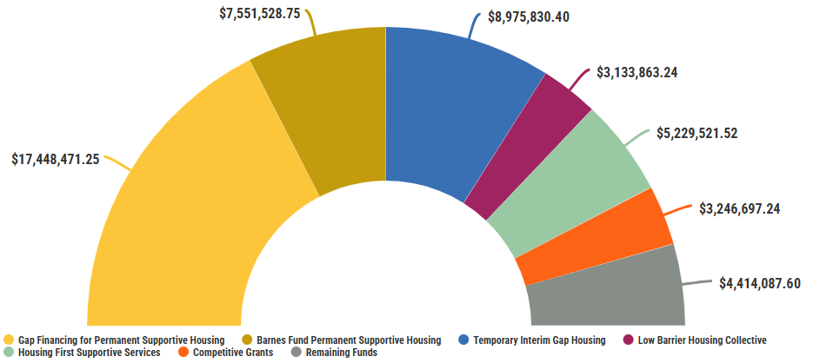
Total Spending Breakdown
15
UPDATE: March 2026
Remaining Funds include ARP as well as the $500,000 COVID CARES funding awarded to the Low Barrier Housing Collective.
Notes:
Housing Surge:
The next encampment will be announced in the upcoming months
Prioritizing
Assessing
Decompressing
Permanent Housing surge will be executed the last 2 weeks of June
PHS
Voucher Subsidies
MDHA Properties
Private Owners
Housing Navigation to increase MDHA voucher subsidy utilization
Two Week Surge
Increase Community Capacity
Eliminating loss of resources
Community Partner’s Upcoming Priorities
Family Housing Surge
Chronic Housing Surge
Shelter Support
Encampment Support

Slide 16
Encampment Data
16
UPDATE: March 2026
 |  | 2023 Camp Closures (Brookmeade, Caldwell Park, TA Truck Stop, and Hermitage Camps) | Old Tent City | River Camp | Cement Plant Road | Total Admissions
 | Hospitality Hub | - | 83 | 0 | 0 | 83
 | Community Care Fellowship | 33 | 3 | 1 | 0 | 37
 | Salvation Army | 144 | 1 | 0 | 0 | 145
 | No Interim Gap Housing Placement | 11 | 21 | 37 | 7 | 76
 | Total Individuals | 188 | 108 | 38 | 7 | 341
 | Exit Destination of Former Camp Residents | Hospitality Hub | Community Care Fellowship | Salvation Army | No Interim Gap Housing Placement
 | Still Enrolled In Program | 39 | 0 | 1 | 0
 | Permanent Housing | 18 | 11 | 116 | 66
 | Deceased | 0 | 0 | 7 | 0
 | Returned to Homelessness | 13 | 20 | 3 | 3
 | Incarceration | 9 | 0 | 14 | 5
 | Hospital/Treatment Center | 1 | 3 | 0 | 0
 | Hotel | 0 | 2 | 0 | 0
 | Staying with Friends/Family (temporary) | 2 | 1 | 1 | 2
 | Unknown | 1 | 0 | 3 | 0
*All data as of 2/28/2026

Slide 17
$9M Interim Gap Housing RS 2022-1698
17
UPDATE: April 2025
Final Program Numbers
 |  | Community Care Fellowship ARP Funding | Launch Pad* | Community Care Fellowship CARES Funding** | The Salvation Army
 | Number of Sites | 4 | 1 | 2 | 1
 | Total Number Served | 375 | 16 | 87 | 144
 | Total Number Exited | 335 | 10 | 87 | 144
 | Average Length of Stay | 115 Days | 96 Days | 61 Days | 334 Days
 | Chronically Homeless | 61.3% | 37.5% | 67.8% | 86.8%
 | Veteran Status | 4.0% | 0.0% | 3.4% | 4.2%
 | At Least 1 Disabling Condition | 78.7% | 81.3% | 88.5% | 97.9%
 | 2 or More Disabling Conditions | 53.1% | 25.0% | 60.9% | 78.5%
 | Has Income at Exit | 46.9% | 60.0% | 39.1% | 11.1%
 | Has Non-Cash Benefits at Exit | 34.3% | 20.0% | 35.6% | 66.0%
 | Has Health Insurance at Exit | 57.6% | 70.0% | 47.1% | 69.4%
 | Entries from Encampment Closures | 8.8% | 0.0% | 0.0% | 100.0%
 | Exits to Permanent Housing | 47.8% | 50.0% | 34.5% | 80.6%
 |  | Community Care Fellowship | Launch Pad* | Community Care Fellowship CARES Funding** | The Salvation Army
 | Race and Ethnicity
 | American Indian/Native Alaskan/Indigenous | 0.5% | 0.0% | 0.0% | 0.7%
 | Asian | 0.0% | 0.0% | 0.0% | 0.0%
 | Black | 34.4% | 56.3% | 13.8% | 11.1%
 | Hispanic/Latinx | 0.5% | 0.0% | 0.0% | 0.0%
 | Middle Eastern or North African | 0.0% | 0.0% | 0.0% | 0.0%
 | Native Hawaiian or Pacific Islander | 0.0% | 0.0% | 0.0% | 0.0%
 | White | 57.3% | 18.8% | 81.6% | 84.0%
 | Multi Racial/Ethnic | 7.2% | 12.5% | 4.6% | 4.2%
 | Client Declined to Answer | 0.0% | 12.5% | 0.0% | 0.0%
 | Age
 | 0-17 | 14.7% | 0.0% | 1.1% | 0.0%
 | 18-24 | 2.9% | 100.0% | 0.0% | 1.4%
 | 25-34 | 12.0% | 0.0% | 12.6% | 29.9%
 | 35-44 | 21.3% | 0.0% | 31.0% | 35.4%
 | 45-54 | 23.2% | 0.0% | 33.3% | 27.1%
 | 55-64 | 21.1% | 0.0% | 12.6% | 5.6%
 | 65+ | 4.8% | 0.0% | 9.2% | 0.7%
*Launch Pad operated a youth specific Mobile Housing Navigation Center through a partnership with Community Care Fellowship through December 2024. All funding for this program is distributed through Community Care Fellowship.
**Prior to receiving ARP funds, Community Care Fellowship received CARES (Coronavirus Aid, Relief, and Economic Security) funding to operate their shelter programs. A recent review of these programs showed that an error had been made in identifying the ending date of the CARES funding and the beginning of the ARP funding. As such, the number served under the ARP funding has been edited to reflect the correct number served.
All data as of 1/31/25
Notes:
The Salvation Army (TSA) – Roadway Home
All are on ARP Gap Funds with TSA
Remainder will be working on housing options including interim housing, permanent supportive housing, or permanent housing options such as Section 8
Housing NOLA transitioning case management to The Salvation Army staff
Community Care Fellowship – Mobile Housing Navigation Centers
4 Mobile Housing Navigation Centers are currently open
The Family Center will open by July 1, 2023
The Youth Center will open by September 1 , 2023
Community Care Fellowship’s ARP-1 funding ended on March 31, 2023 when the program funds were completely spent.
Beginning April 1, 2023 all Mobile Housing Navigation Centers became funded by the 2022 ARP Funding (ARP-2).
At the time of the transition, 16 clients remained in the ARP-1 programs and were transitioned over to the ARP-2 funding.

Slide 18
$9M Interim Gap Housing RS 2022-1698
18
UPDATE: April 2025
Final Spending Update:
 | Total Funds | Spending as of 1/31/25 | Remaining Funds | Funding End Date
Community Care Fellowship ARP* | $4,542,355.00 | $4,542,354.99 | $0.01 | 10/4/2024
The Salvation Army | $4,457,645.00 | $4,433,475.41 | $24,169.59 | 10/31/2024
Total Funding** | $9,000,000.00 | $8,975,830.40 | $24,169.60
*Spending by Community Care Fellowship encompasses the combined spending for the Community Care Fellowship and Launch Pad Mobile Housing Navigation Centers.
**Total Funding includes only ARP funding and not the previously awarded CARES funding.
Totals based on all invoices received for expenses
occurring through 1/31/25

Slide 19
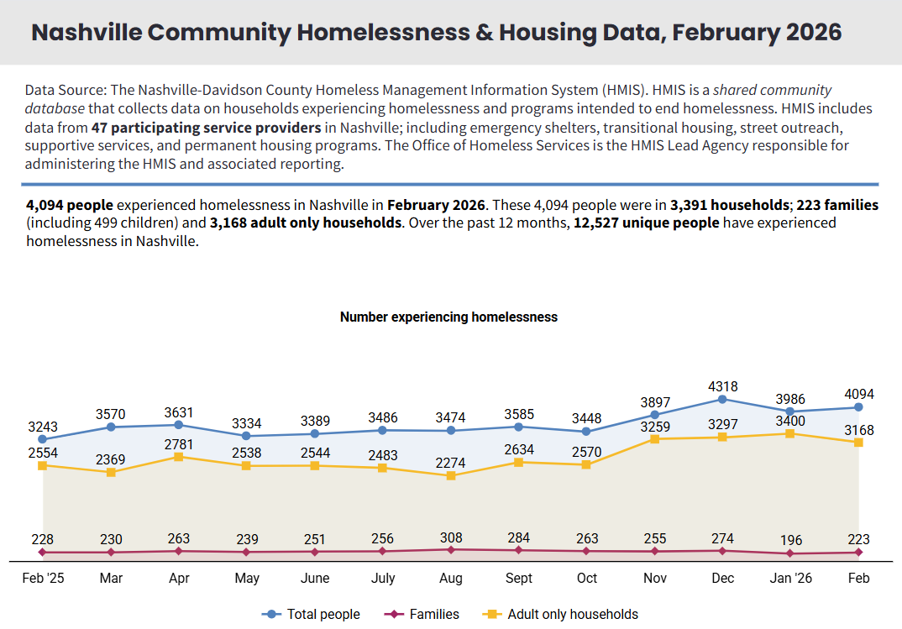
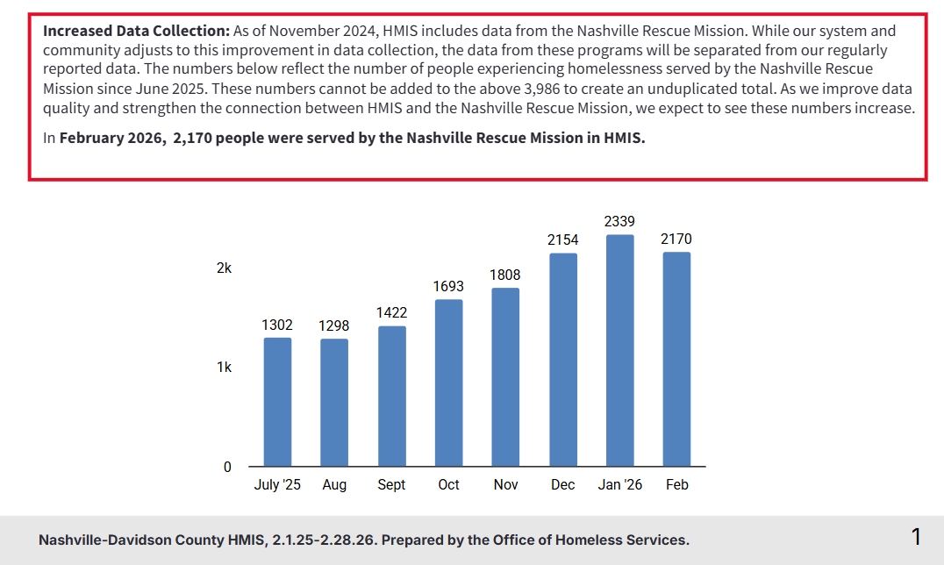
Nashville Homelessness Data
19

Slide 20
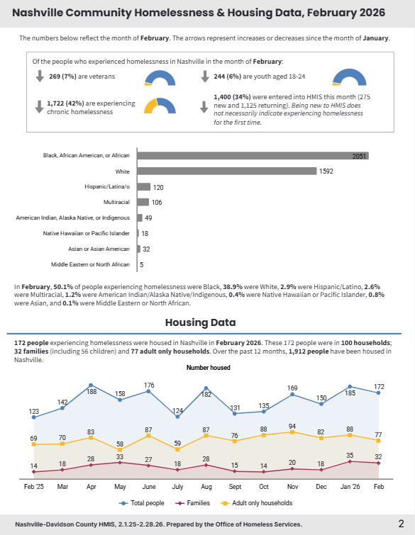
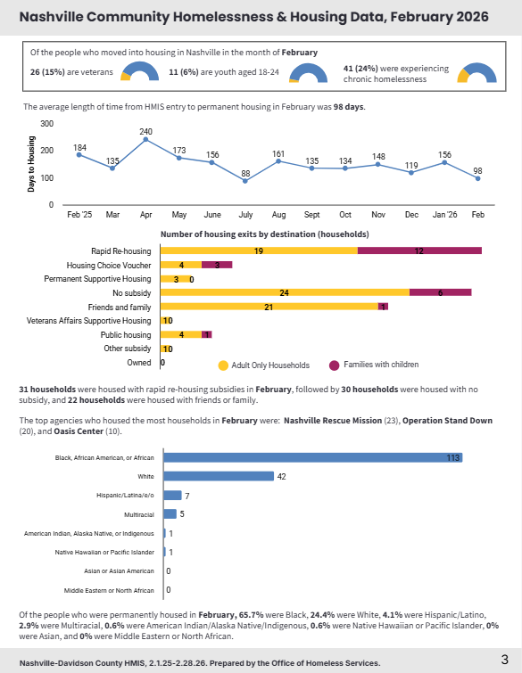
Nashville Homelessness Data
20

